Slide 1
Introduction to Graphical User Interfaces (GUIs)

Slide 2
GUI Development Environment (guide)
Download the ProjectTutorialCode.m file from Blackboard and put it in you current MATLAB folder!

Slide 3
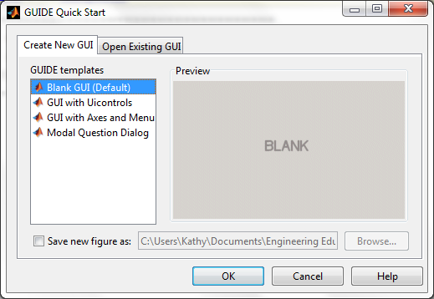
GUI Development Environment (guide)
At the command prompt in MATLAB, type
>> guide
Select the option to
Create New GUI,
Blank GUI (Default)

Slide 4
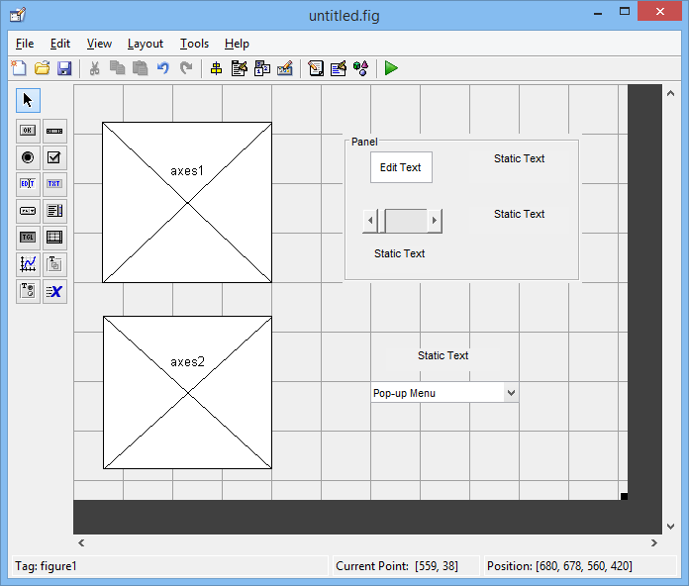
Add Objects
Drag and drop components from the menu of icons to create this GUI:

Slide 5
Set up Properties of Objects
Right click in the GUI block (not on any specific object) and select Property Inspector. Pick a name for the GUI like FirstGui. Leave the property inspector open.
Click on the top Edit Text block. In the property inspector for this box: set the String to 1 (the number one) and set the Tag to FreqBox.
Caution: Make sure you make the tag names exactly the same as what is specified. Otherwise the code you are going to copy and paste won’t run!

Slide 6
Set up Properties of Objects
Click on the top static text block and set the String to Frequency (Hz).
Click on the slider and set the Value to 5 (do this by clicking on the little icon next to Value then clicking on the 0.0 and overwriting it with 5 (don’t Append). Set the Max to 10. Set the Tag for the slider to AmpSlider.
Click on the Static Text box under the slider. In the property inspector, set the String to 5 and the Tag to AmpBox.
Click on the static text block to the right of the slider and make the string Amplitude.

Slide 7
Set up Properties of Objects
Click on the static text block above the pop up menu and set the String to Select a Graph.
Click on the pop up menu block and set the Tag to GraphMenu and set the String to the following:
cos(2*pi*t)
tan(t)
ln(t)
Make sure cos(2*pi*t) is on the very first line – don’t leave a blank line at the top.

Slide 8

Your GUI should now look like this:

Slide 9
Activate Your GUI
Click on the Green Play arrow to activate the GUI.
Save the GUI under some name (FirstGui). Note: name must follow same rules as naming variables in MATLAB!
An m-file will automatically open (with the same name)
The GUI which currently does almost nothing at this point will launch.
The m-file has callback functions where code can be added to control what the various objects (pushbuttons, drop down menus, plots, etc) will do. Any executable MATLAB code can be placed within these functions.

Slide 10
Activate Your GUI
At this point, your GUI does almost nothing.
You can move the slider back and forth
Caution: don’t click really fast on the arrows next to the slider or MATLAB will lock up!
You can select something from the pop-up menu
You can write stuff in the edit box

Slide 11
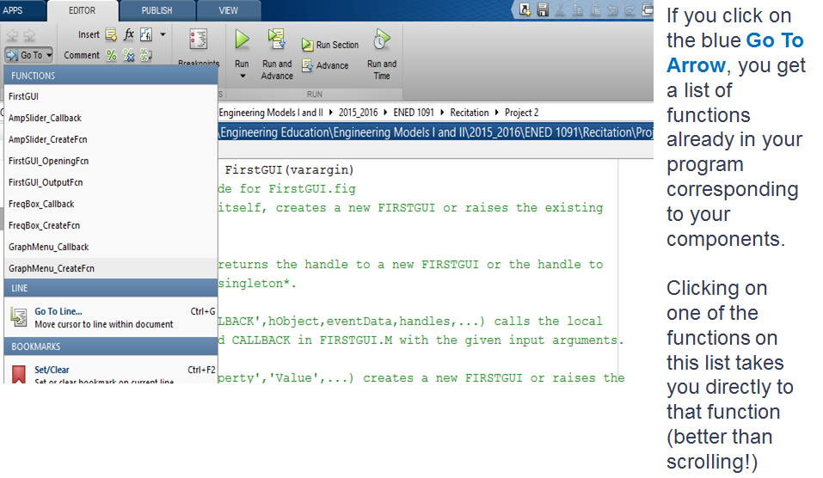
Writing Code for Components

Slide 12
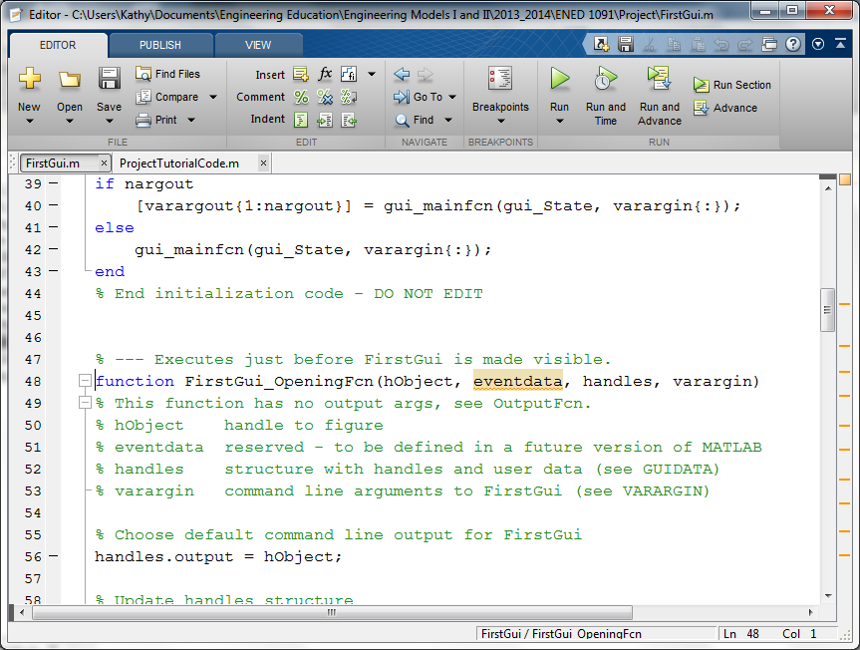
Opening Function
1. Copy lines 3-12 from the ProjectTutorialCode.m file.
2. Go back to the FirstGui.m file, click on the Go To Arrow and select FirstGui_OpeningFcn
3. Paste the code you just copied right below the first five lines of comments but before the first executable command that is already in the opening function

Slide 13
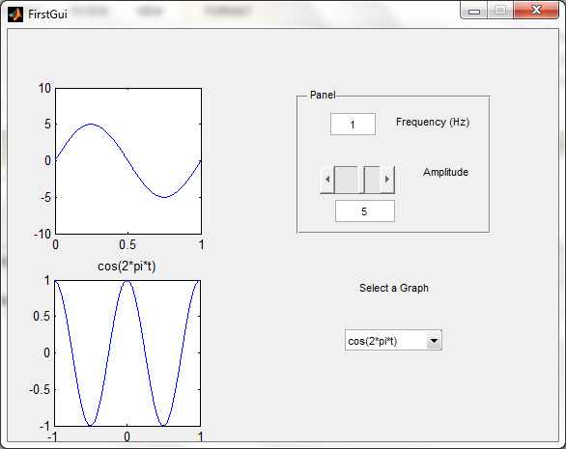
Opening Function
Hit the Green Arrow to Save Your Changes and launch the GUI again.
Now you should have something in your two plot windows:

Slide 14
Opening Function
%The Opening Function Sets up how FirstGui looks when first opened
axes(handles.axes1); % Point to the top plot tagged as axes1
% Plot a 1 Hz sine wave with amplitude of 5
t = 0:1e-6:1; y = 5*sin(2*pi*t);
plot(t,y); axis([0 1 -10 10]);
axes(handles.axes2); % Point to the bottom plot tagged as axes2
% Plot a 1 Hz cosine wave with amplitude of 1
t = -1:0.001:1; y = cos(2*pi*t); plot(t,y); title('cos(2*pi*t)');

Slide 15
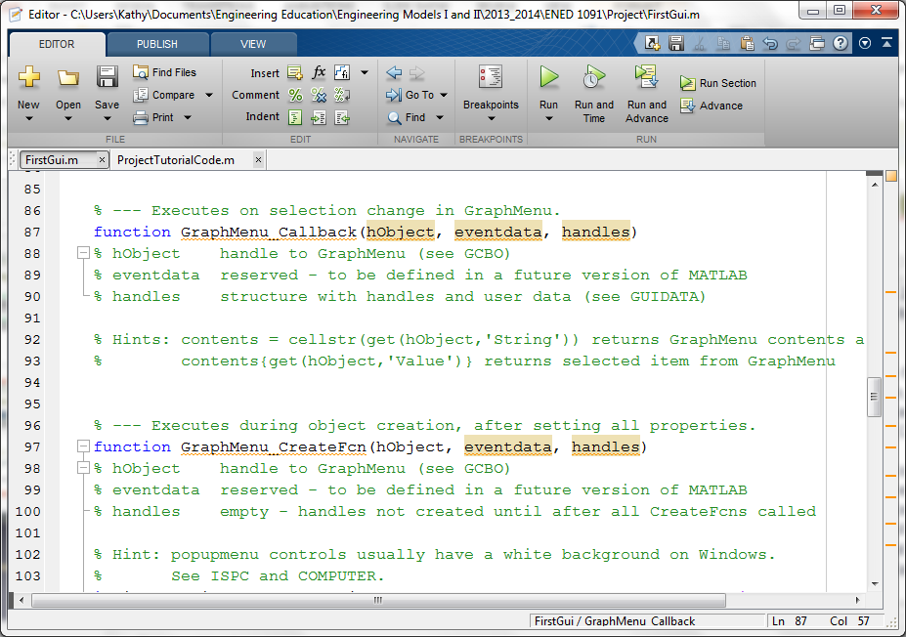
Pop-Up Menu (GraphMenu)
1. Copy lines 17-31 from the ProjectTutorialCode.m file.
2. Go back to the FirstGui.m file, click on the Go To Arrow and select GraphMenu_Callback
3. Paste the code you just copied right below the Hints in the GraphMenu_Callback function
Caution: don’t accidently paste in the GraphMenu_CreateFcn

Slide 16
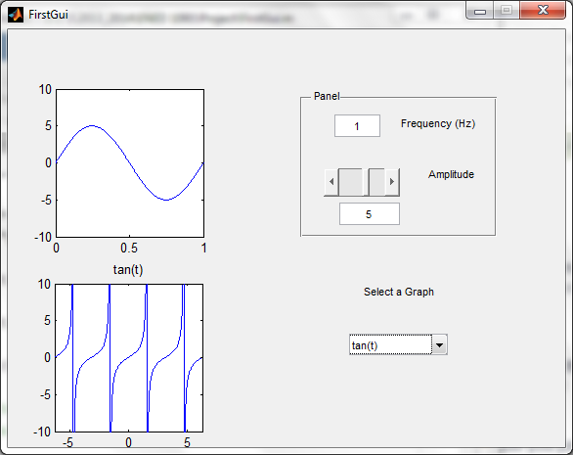
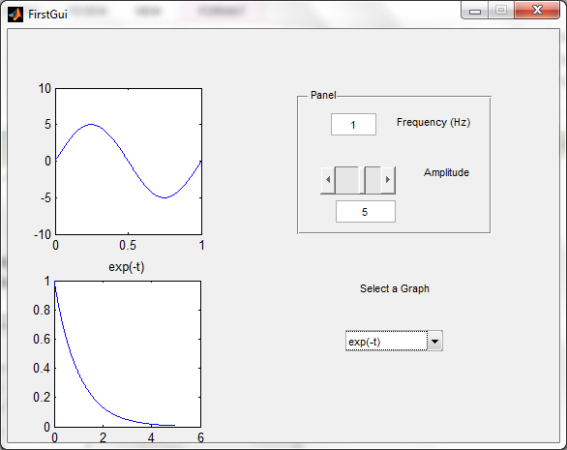
Pop-Up Menu
Hit the Green Arrow to Save Your Changes and launch the GUI again.
Select different items from the pop-up menu and see graph change!

Slide 17
Pop-Up Menu
axes(handles.axes2); % Makes axes2 the selected plot window
cla; % Clears axes2
menu_choice = get(handles.GraphMenu, 'Value');
% Get user choice from pop-up menu tagged as menu1
switch menu_choice
case 1
t = -1:0.001:1; y = cos(2*pi*t); plot(t,y);
title('cos(2*pi*t)');
case 2
t = -2*pi:0.001:2*pi; y = tan(t);
plot(t,y); axis([-2*pi 2*pi -10 10]); title('tan(t)');
case 3
t = 0.1:0.001:5; y = log(t);
plot(t,y); title('ln(t)');
end

Slide 18
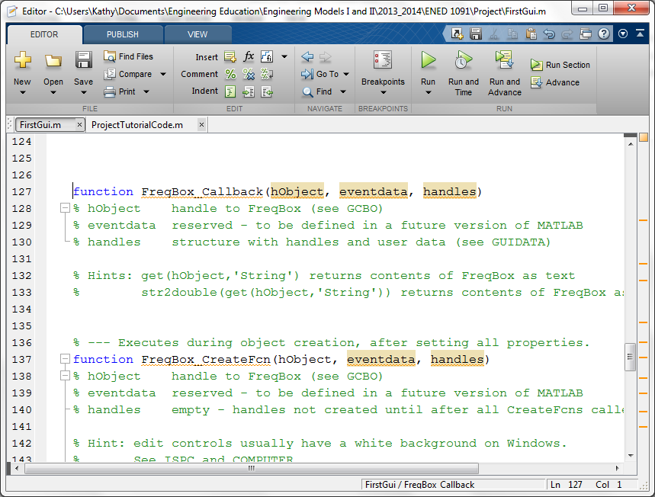
Edit Box (FreqBox)
1. Copy lines 36-55 from the ProjectTutorialCode.m file.
2. Go back to the FirstGui.m file, click on the Go To Arrow and select FreqBox_Callback
3. Paste the code you just copied right below the Hints in the FreqBox_Callback
Caution: don’t accidently paste in the FreqBox_CreateFcn

Slide 19
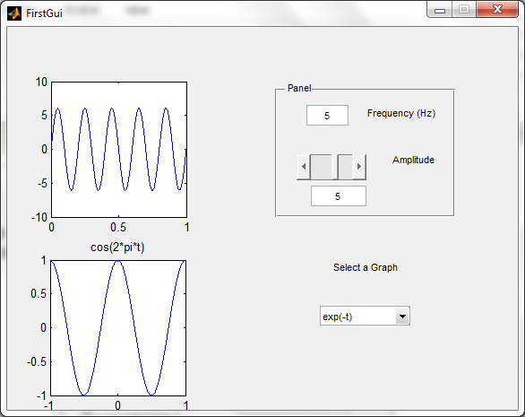
Edit Box (FreqBox)
Hit the Green Arrow to Save Your Changes and launch the GUI again.
Type different values in the FreqBox Edit Box and see the top graph change

Slide 20
Edit Box (FreqBox)
freq = str2double(get(handles.FreqBox,'String'));
% Get the frequency from box tagged FreqBox
if isnan(freq)
% If freq isn't a number over-write it with a 1
freq = 1;
set(handles.FreqBox, 'String',1); % Write a 1 into the box
errordlg('Input must be a number');
% Tell user to put in a number
pause(2);
end
amp = get(handles.AmpSlider,'Value'); % Get amplitude from Slider tagged AmpSlider
axes(handles.axes1); %Select axes1 for plotting
cla; %Clear out axes 1
t = 0:1e-6:1;
y = amp*sin(2*pi*freq*t);
plot(t,y); axis([0 1 -10 10]);

Slide 21
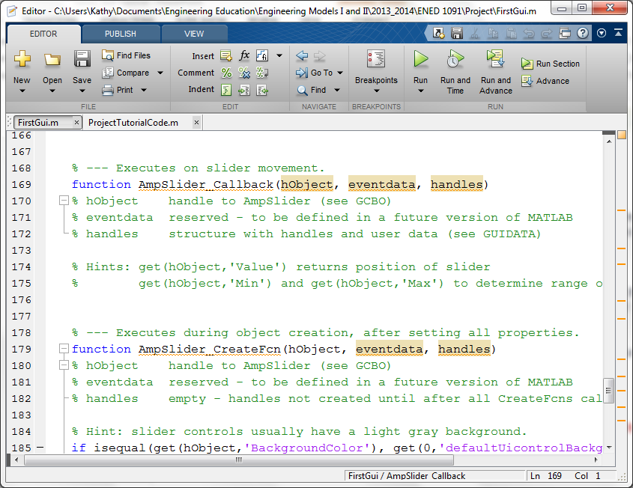
Slider (AmpSlider)
1. Copy lines 60-71 from the ProjectTutorialCode.m file.
2. Go back to the FirstGui.m file, click on the Go To Arrow and select AmpSlider_Callback
3. Paste the code you just copied right below the Hints in the AmpSlider_Callback
Caution: don’t accidently paste in the AmpSlider_CreateFcn

Slide 22
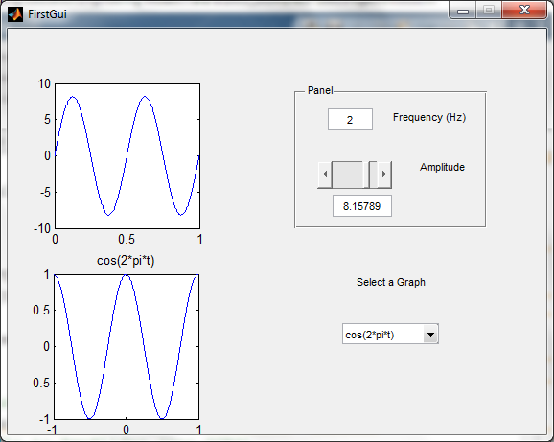
Slider (AmpSlider)
Hit the Green Arrow to Save Your Changes and launch the GUI again.
Move the slider and see the amplitude of the sin wave change and the value in the box change. Caution: don’t click really fast on the arrows next to the slider or MATLAB will lock up!

Slide 23
Slider (AmpSlider)
amp = get(handles.AmpSlider, 'Value'); % Get the new slider value
freq = str2double(get(handles.FreqBox,'String'));
% Get frequency from box tagged FreqBox
axes(handles.axes1); %Select axes1 for plotting
cla; %Clear out axes 1
t = 0:1e-6:1;
y = amp*sin(2*pi*freq*t);
plot(t,y); axis([0 1 -10 10]);
set(handles.AmpBox, 'String',amp);
% Writes value of slider into static text box tagged AmpBox

Slide 24
Key Commands

Slide 25
What is handles?
handles is a structure that has contains all of the properties of all of the objects added to your GUI.
Think of handles as being similar to a dataset array. In our dataset array of weather data, CVG, we referenced the maximum daily temperature column as CVG.TMAX. In a GUI, we refer to an object as handles.TagName

Slide 26
Programming a GUI: Key Commands
The get command allows you to retrieve any property of any component in your GUI.
The set command allows you to set any property of any component in your GUI.
The PowerPoint, Guide to GUIs, posted in the recitation folder on the metasite under Team Project #2 has details on key properties for each component.

Slide 27
Common Errors

Slide 28
Common Errors
The usual syntax errors and spelling errors that create problems in writing any program. Learn to spell handles!
Using the same name for a tag and for a variable. For example, if you have an edit box that has a tag, Amplitude, don’t use Amplitude as a variable name in your program.
Don’t end the individual callback functions. If you do, all functions underneath won’t be recognized – you’ll get a red line under all remaining functions. Of course, you do have to include end statements for all conditional statements and loops.

Slide 29
Common Errors
Double clicking on the .fig file will not activate your GUI. It will look OK but when you try to do something, you will get errors. You activate your GUI by typing the name of the GUI.m file at the command prompt or by opening the .m file and clicking on the green activate arrow.
If you decide for some reason to re-name your GUI, you cannot do this by simply re-naming the .m and .fig files. You must re-open your GUI using guide, then do a save as with the new name. MATLAB will create a new .m and .fig file with the new name. The .m file will have all of your original code but is adapted to the new name.

Slide 30
Common Errors
In addition to a CallBack Function, each component also generates a Create Function in your m-file. Don’t delete these Create Functions. If you do inadvertently delete one, simply go back to your GUI layout (guide). Right click on the component, select View Callbacks, then click on Create Function. This will put the Create Function back in your m-file.
If you want to send a GUI to the members of your team, you must send both the .fig and .m files You will also need to do this when you submit your final project.

